Slide 1

“Your Project Name”
INTERNET BANKING WEBSITE
Task - 2

Slide 2
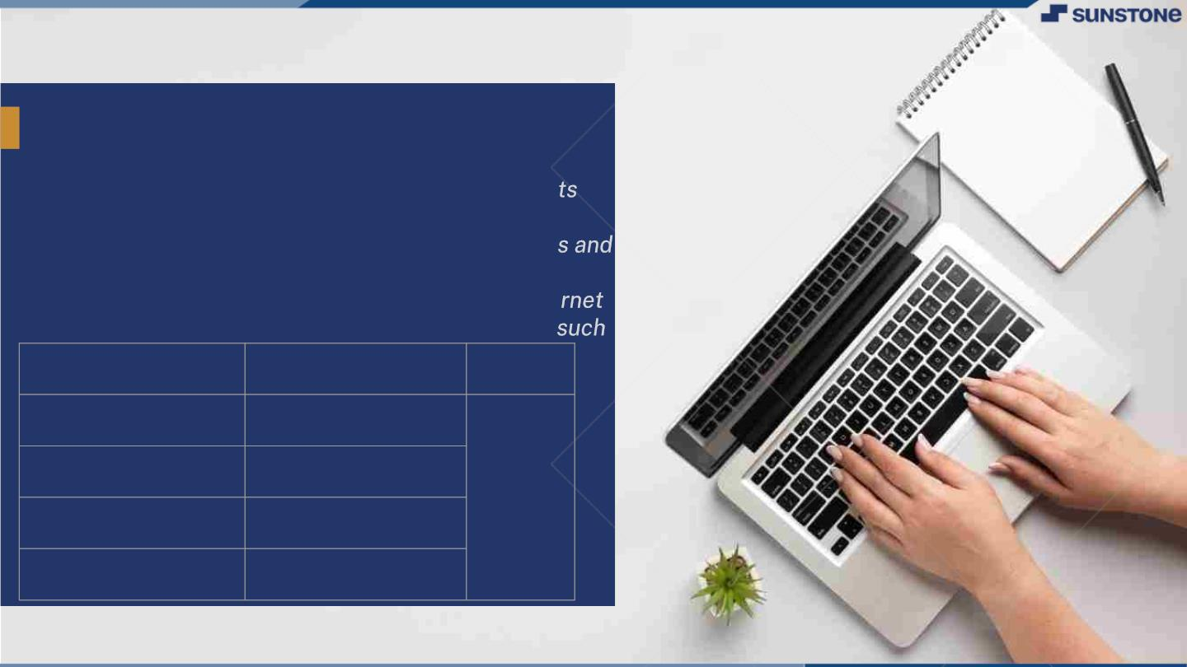
InternetꢀBankingꢀWebsite
Internet banking is a digital platform that allows
customers to access and manage their bank accoun
online. It is designed specifically for online banking
transactions. It typically provides a range of feature
services, including account balance inquiries, funds
transfers, bill payments, and online statements. Inte
banking websites use advanced security measures,
as encryption and multi-factor authentication.
LMS Username
Name
Batch
2115a831
ROSHAN T
2115a826
RAGHUVARANAN C
JAISHUK R
A8
2115a88
2115a81
SRISARAVANAN K

Slide 3

Step-WiseꢀDescription
• Register for Online Banking: The first step to using an internet banking system is to
register for online banking with your bank. You will need to provide some personal
information and create a username and password.
• Log in: Once you have registered, you can log in to your internet banking account using
your username and password.
• View Account Information:After logging in, you can view your account information such
as account balance, transaction history, and pending transactions.
• Transfer Funds: You can transfer funds between your accounts or to other accounts
within the same bank or other banks. You will need to provide the recipient's account
number, bank name, and routing number.
• Pay Bills: You can pay bills online by setting up a bill pay account and entering your bill
details. The system will automatically pay your bills on the due date.
• Apply for Loans: You can apply for loans online by filling out a loan application and
submitting it through the internet banking system.
• Logout: After you have finished using the internet banking system, remember to log out
of your account to ensure the security of your information.

Slide 4

Submission Github
https://github.com/srisaravanan02/Naan-
Mudhalvan2https://github.com/roshan-
2501/Internet-Banking-Website

Slide 5


